Slide 1
Abstract Class

Slide 2
Abstract Class
A class that is declared using “abstract” keyword is known as abstract class.
It can have abstract methods(methods without body) as well as concrete methods (regular methods with body).
A normal class (non-abstract class) cannot have abstract methods.
Points to Remember
An abstract class must be declared with an abstract keyword.
It can have abstract and non-abstract methods.
It cannot be instantiated.
It can have constructors and static methods also.
If a child does not implement all the abstract methods of abstract parent class, then the child class must need to be declared abstract as well.

Slide 3
Why we need an abstract class?
Lets say we have a class Animal that has a method sound() and the subclasses(see inheritance) of it like Dog, Lion, Horse, Cat etc.
Since the animal sound differs from one animal to another, there is no point to implement this method in parent class.
This is because every child class must override this method to give its own implementation details, like Lion class will say “Roar” in this method and Dog class will say “Woof”.

Slide 4
Why we need an abstract class?
Thus, making this method abstract would be the good choice as by making this method abstract we force all the sub classes to implement this method( otherwise you will get compilation error), also we need not to give any implementation to this method in parent class.
Since the Animal class has an abstract method, you must need to declare this class abstract.

Slide 5
Abstract class declaration
An abstract class outlines the methods but not necessarily implements all the methods.
//Declaration using abstract keyword
abstract class A{
//This is abstract method
abstract void myMethod();
//This is concrete method with body
void anotherMethod(){
//Does something
}
}

Slide 6
Abstract class Example
//abstract parent class
abstract class Animal{
//abstract method
public abstract void sound();
}
//Dog class extends Animal class
public class Dog extends Animal{
public void sound(){
System.out.println("Woof");
}
}
// BigDog class extends Dog class
public class BigDog extends Dog{
public void sound(){
System.out.println("Woow!");
}
}
//Cat class extends Animal class
public class Cat extends Animal{
public void sound(){
System.out.println(“Meao");
}
}

Slide 7
Abstract class Example
public class TestAnimal {
public static void main(String args[]){
// Using the subclasses
Cat cat1 = new Cat();
cat1.sound();
Dog dog1 = new Dog();
dog1.sound();
BigDog bigDog1 = new BigDog();
bigDog1.sound();
// Using Polymorphism
Animal animal1 = new Cat();
animal1.sound(); //call to subclass Cat version
animal1 = new Dog();
animal1.sound(); //call to subclass Dog version
animal1 = new BigDog();
animal1.sound(); //call to subclass BigDog version
animal1 = new Animal(); //Compiler Error
animal1.sound(); /// Compiler Error
since it calls parent version’s method which is abstract!!!!!!!
}}

Slide 8
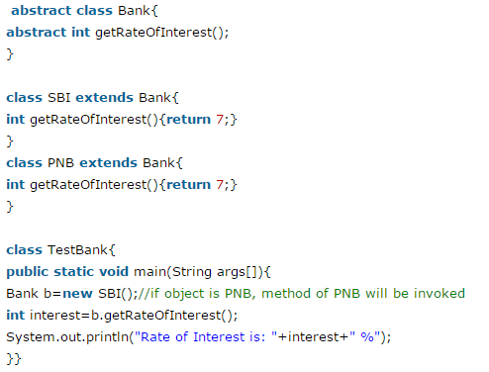

Abstract class Example
OUTPUT:

Slide 9
Abstract class has Constructor in Java
Now, if we say we can not create an instance of an abstract class then why do Java adds a constructor in the abstract class?
One of the reasons which make sense is when any class extends an abstract class, the constructor of sub class will invoke the constructor of super class either implicitly or explicitly.
This chaining of constructors is one of the reasons abstract class can have constructors in Java.

Slide 10
Abstract class has Constructor in Java
public class AbstractConstructorTest {
public static void main(String args[]) {
Server server = new Tomcat("Apache Tomcat");
server.start();
}
}
abstract class Server{
protected String name;
public Server(String name){
this.name = name;
}
public abstract boolean start();
}
class Tomcat extends Server{
public Tomcat(String name){
super(name);
}
@Override
public boolean start() {
System.out.println( this.name + " started successfully");
return true;
}
}
Output:
Apache Tomcat started successfully

Slide 11
Why can’t we create the object of an abstract class?
Because these classes are incomplete, they have abstract methods that have no body so if java allows you to create object of this class then if someone calls the abstract method using that object then What would happen? There would be no actual implementation of the method to invoke.
Also because an object is concrete. An abstract class is like a template, so you have to extend it and build on it before you can use it.

Slide 12
Points to Remember
1) In Java, an instance of an abstract class cannot be created,
we can have references of abstract class type though.
2) An abstract class can contain constructors in Java. And a constructor of abstract class is called when an instance of a inherited class is created.
3) In Java, we can have an abstract class without any abstract method.
This allows us to create classes that cannot be instantiated, but can only be inherited.
4)Abstract classes can also have final methods (methods that cannot be overridden).
5) For any abstract java class we are not allowed to create an object i.e.,
for abstract class instantiation is not possible.

Slide 13
Reading Materials
Chapter Eight of your text book.

